Slide 1
A Mix-domain Multimedia Algorithm in Video Segmentation
Yihan Sun
CS&T 05
syhlalala@gmail.com

Slide 2
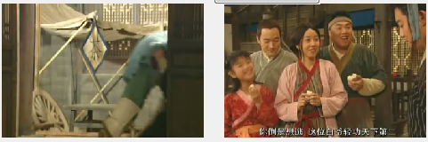
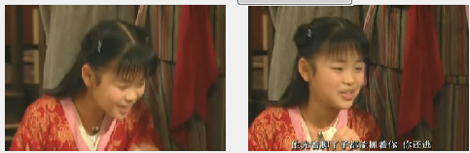
Are they shot by the same camera?

Slide 3




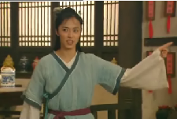
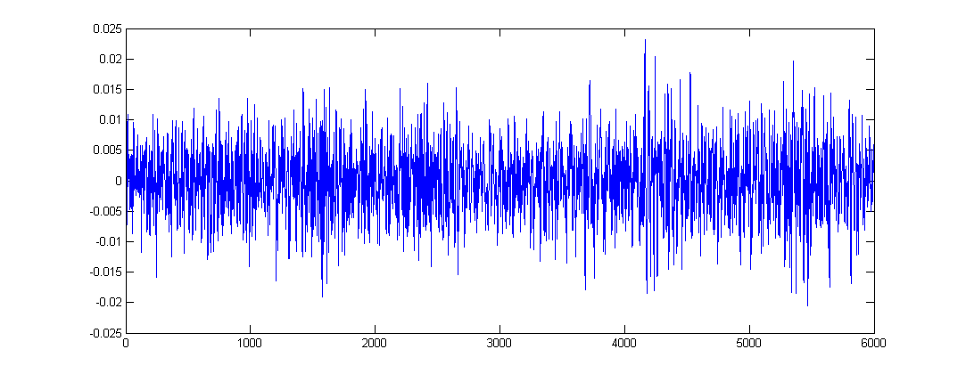
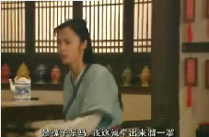
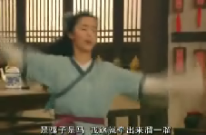
How to detect shots?
$%@！$！$……$@……$%#！
AVI file
So many aspects!
Machine learning!

Slide 4
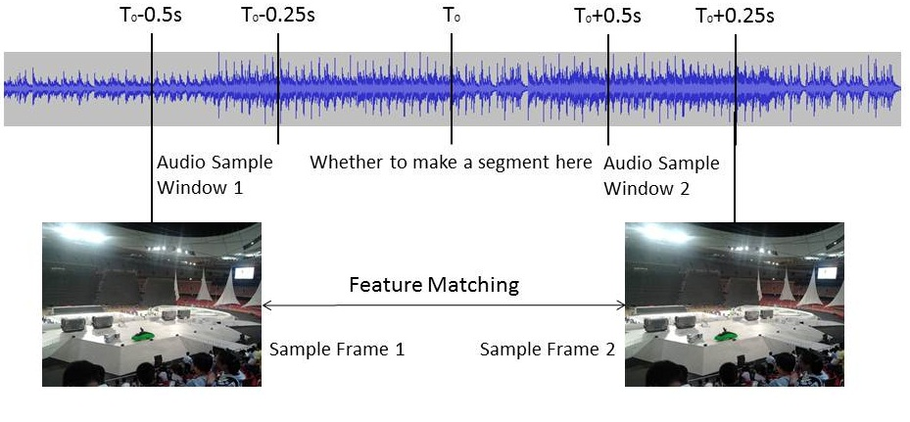
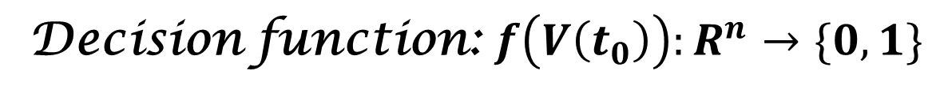
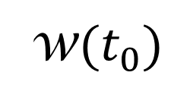
Problem Definition
w$(t_{0})$
$$\overset{⃑}{V}\left(t_{0}\right)=\left(v_{1}\left(t_{0}\right), v_{2}\left(t_{0}\right)…v_{n}\left(t_{0}\right)\right), v_{i}∈w(t_{0})$$
Decision function: $f\left(V\left(t_{0}\right)\right):R^{n}→\{0,1\}$

Slide 5
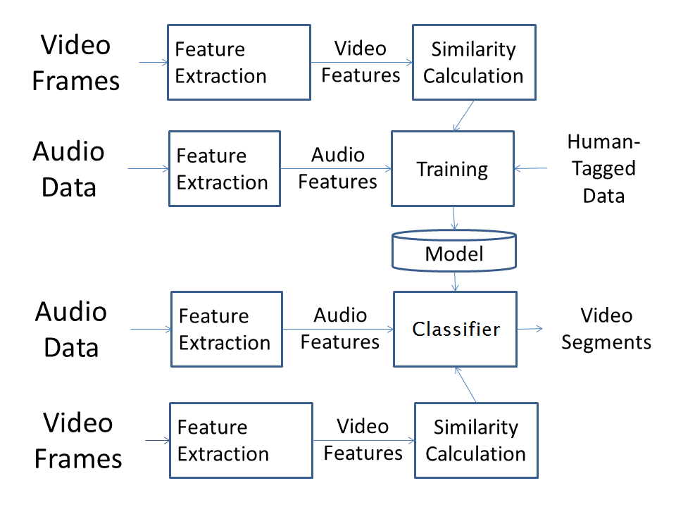
Framework

Slide 6
Task
Classifier to decide video segmentation
Feature extraction
Classifier selection
Analysis performance
Influence of different features

Slide 7
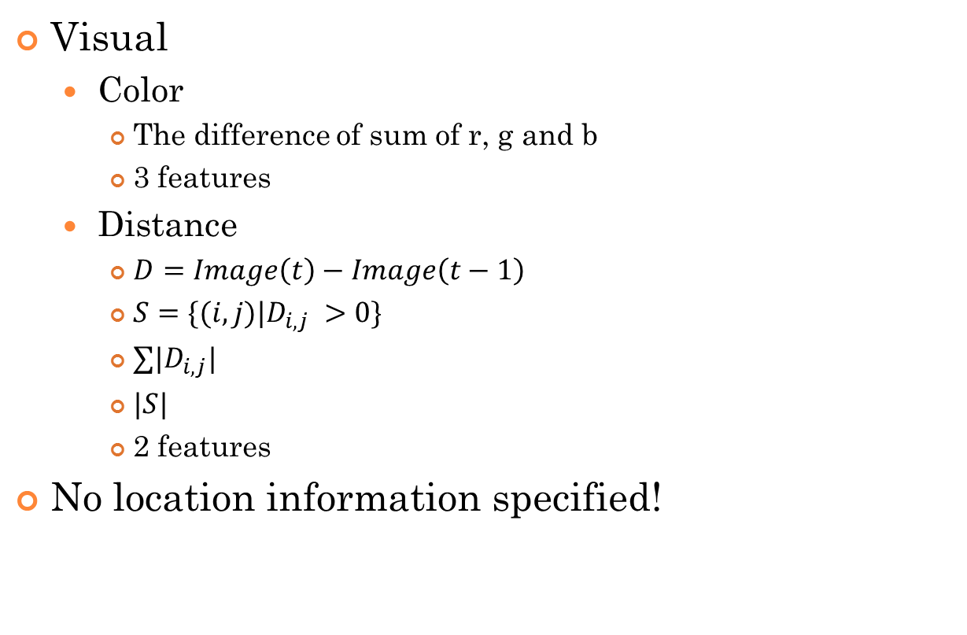
BASELINE: Direct Accessible Features
Visual
Color
The difference of sum of r, g and b
3 features
Distance
$D=Image\left(t\right)−Image\left(t−1\right)$
$S=\{(i,j)|D_{i,j} >0\}$
$∑|D_{i,j}|$
$|S|$
2 features
No location information specified!

Slide 8
BASELINE: Direct Accessible Features
Auditory:
Pitch
Energy
Amplitude
From the neighboring frames: 6 features
Hard to get accurate value

Slide 9
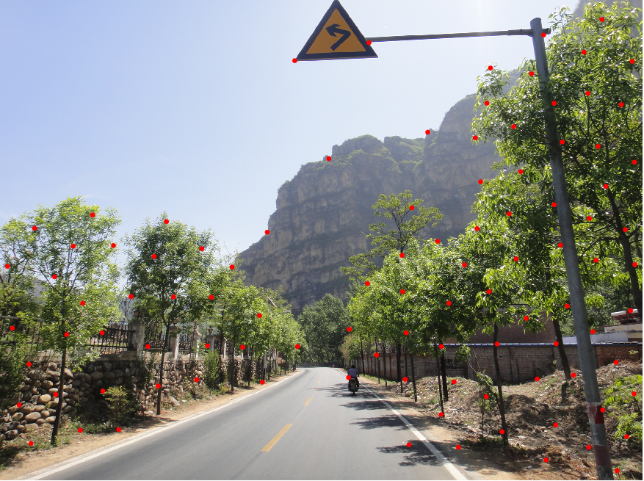
High Level Feature Extraction
What is similar between the frames in the same scene?
Leader role?
Background?
Edge?
Or…corner?

Slide 10
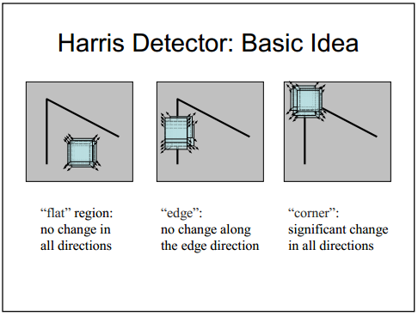
Interest Point Extraction
Corner: Significant change in all directions
Harris Detector

Slide 11
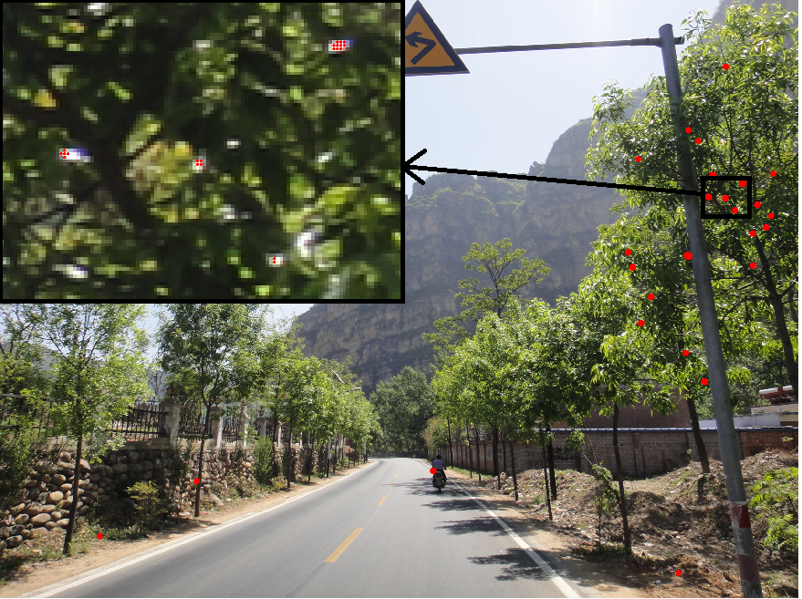
Interest Point Extraction
Adaptive Non-Maximal Suppression(ANMS)
Matthew Brown et al., CVPR 2005
Only those that are a maximum in a neighborhood of radius r pixels are retained

Slide 12
What happened when we shift the shot?
Transformation
Rotation
Scaling
Projection Transformation

Slide 13
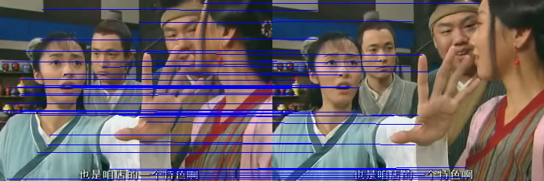
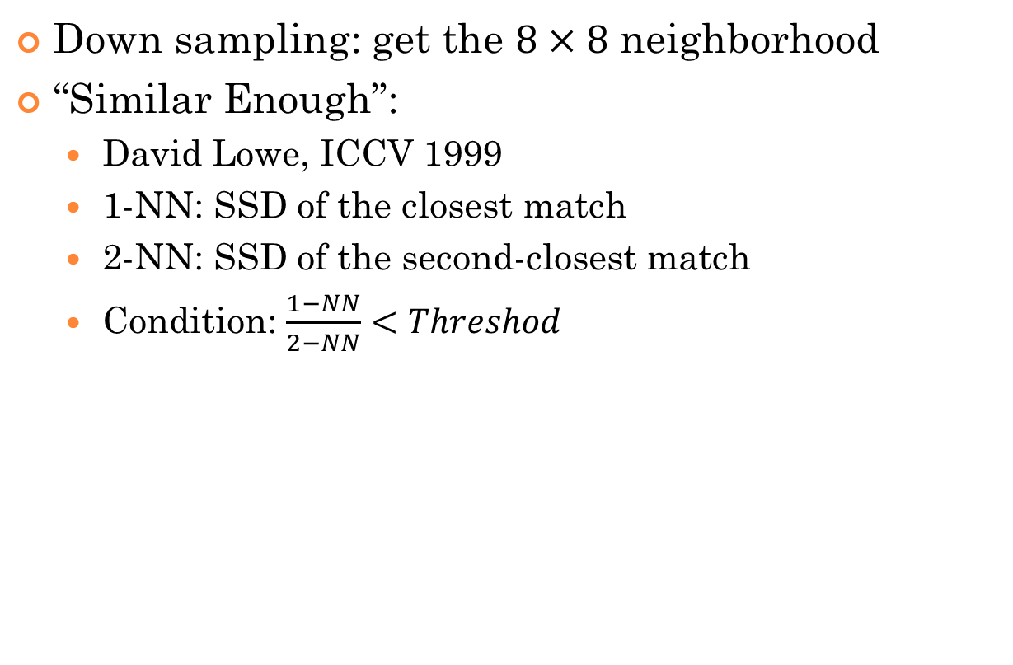
Interest Point Matching
Down sampling: get the $8×8$ neighborhood
“Similar Enough”:
David Lowe, ICCV 1999
1-NN: SSD of the closest match
2-NN: SSD of the second-closest match
Condition: $\frac{1−NN}{2−NN}<Threshod$

Slide 14
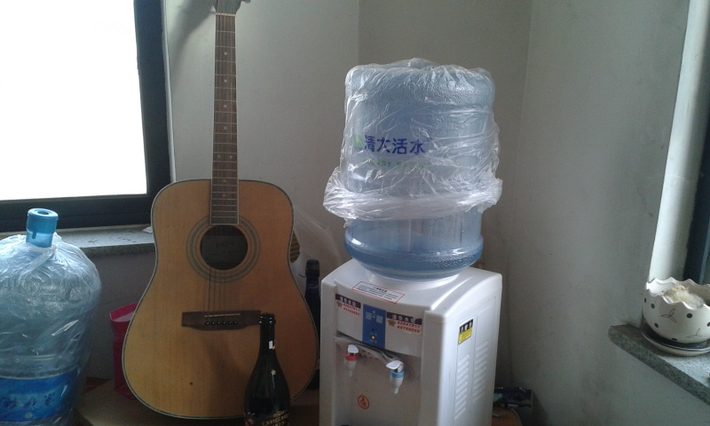
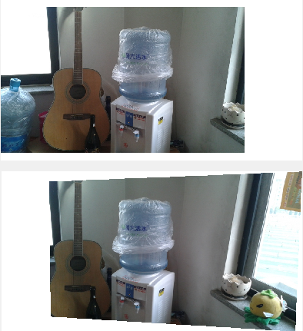
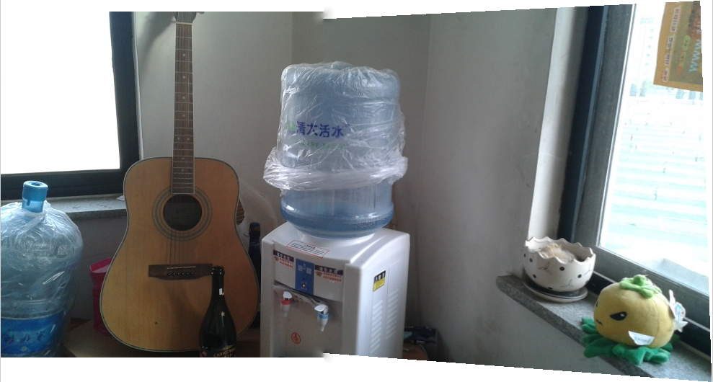
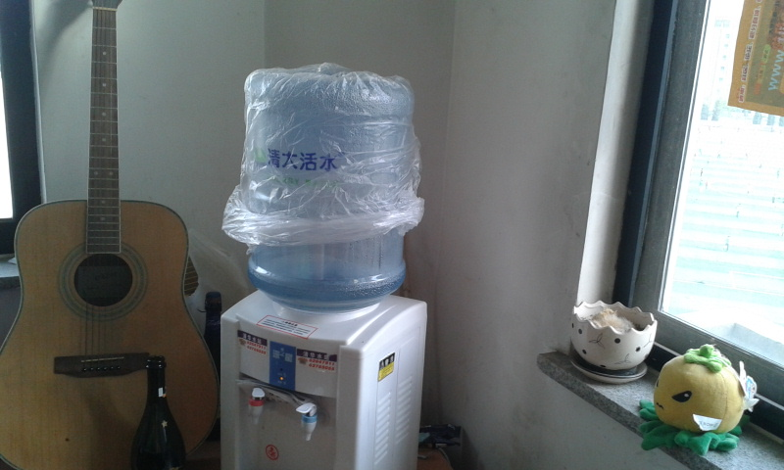

Slide 15
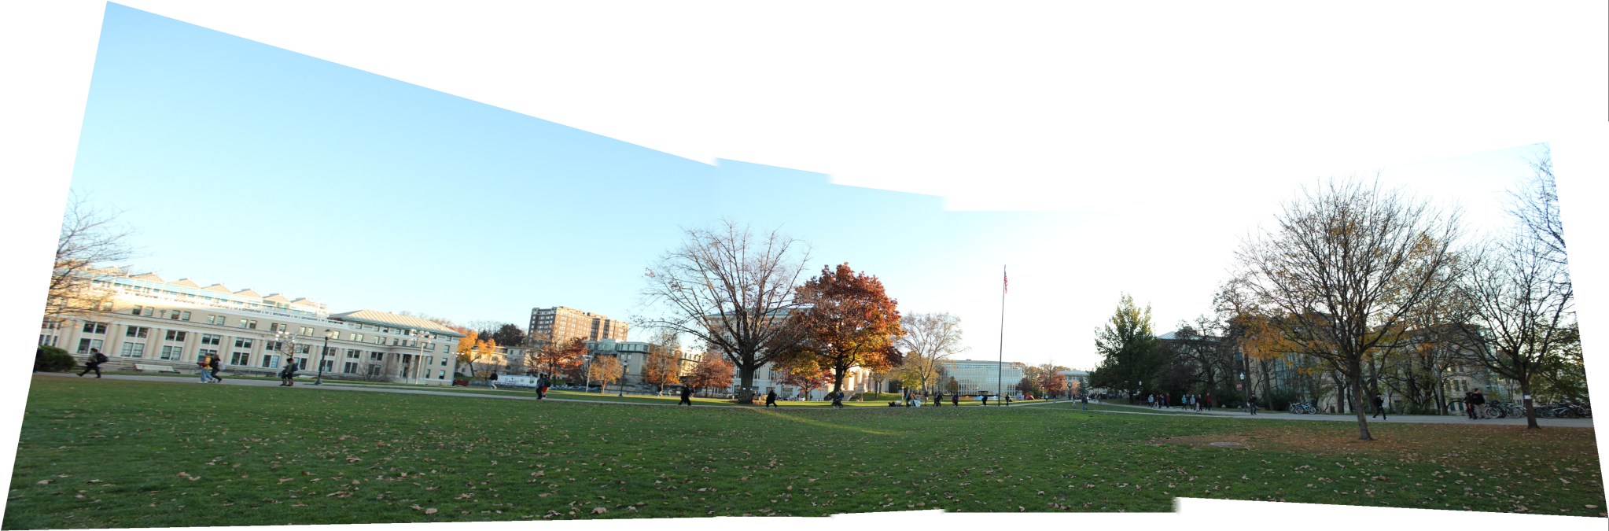

Slide 16
RANSAC
Detecting slow shot shifting in the same scene
Projective Transformation
RANdom SAmple Consensus (RANSAC)
Martin A. Fischler et al, Comm. of the ACM 24 (6), 1981
Given a (usually small) set of inliers, there exists a procedure which can estimate the parameters of a model that optimally explains or fits this data

Slide 17
RANSAC
RANdom SAmple Consensus (RANSAC)
The set of inliers: 4 random interest points
Model parameter: the homography
Indicators:
Best: number of interest points which agree with the homography at most
indicator₁ and indicator_{2 :} ratio of the opposite side under the projective transformation

Slide 18
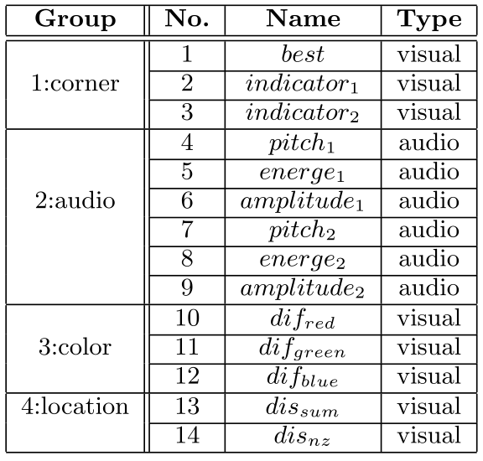
Features

Slide 19
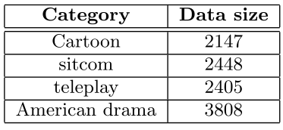
Experiment
Dataset:
Baseline: only with directly accessible features
Algorithm: with corner information

Slide 20
Result - Baseline
category | classifier | precision | recall | F1
cartoon | svm | 0.594(0.171) | 0.493(0.293) | 0.413(0.090)
 | DT | 0.459(0.105) | 0.458(0.096) | 0.454(0.083)
 | KNN | 0.654(0.155) | 0.227(0.097) | 0.332(0.122)
sitcom | svm | 0.457(0.096) | 0.547(0.341) | 0.410(0.201)
 | DT | 0.650(0.026) | 0.651(0.069) | 0.649(0.041)
 | KNN | 0.654(0.054) | 0.349(0.038) | 0.453(0.035)
teleplay | svm | 0.776(0.197) | 0.559(0.298) | 0.706(0.197)
 | DT | 0.738(0.054) | 0.725(0.071) | 0.728(0.037)
 | KNN | 0.703(0.047) | 0.690(0.056) | 0.694(0.033)
American drama | svm | 0.612(0.046) | 0.678(0.216) | 0.630(0.114)
 | DT | 0.685(0.030) | 0.669(0.038) | 0.676(0.023)
 | KNN | 0.685(0.032) | 0.644(0.044) | 0.663(0.026)

Slide 21
Result – with high-level feature
category | classifier | precision | recall | F1
cartoon | svm | 0.482(0.144) | 0.614(0.244) | 0.422(0.119)
 | DT | 0.471(0.080) | 0.450(0.050) | 0.458(0.055)
 | KNN | 0.654(0.155) | 0.227(0.097) | 0.332(0.122)
sitcom | svm | 0.552(0.191) | 0.449(0.292) | 0.490(0.119)
 | DT | 0.675(0.026) | 0.677(0.042) | 0.675(0.025)
 | KNN | 0.654(0.054) | 0.349(0.038) | 0.453(0.035)
teleplay | svm | 0.823(0.079) | 0.586(0.256) | 0.675(0.233)
 | DT | 0.812(0.031) | 0.786(0.043) | 0.798(0.032)
 | KNN | 0.703(0.047) | 0.690(0.056) | 0.694(0.033)
American drama | svm | 0.640(0.091) | 0.472(0.301) | 0.576(0.255)
 | DT | 0.700(0.031) | 0.707(0.036) | 0.703(0.031)
 | KNN | 0.685(0.032) | 0.644(0.044) | 0.663(0.026)

Slide 22
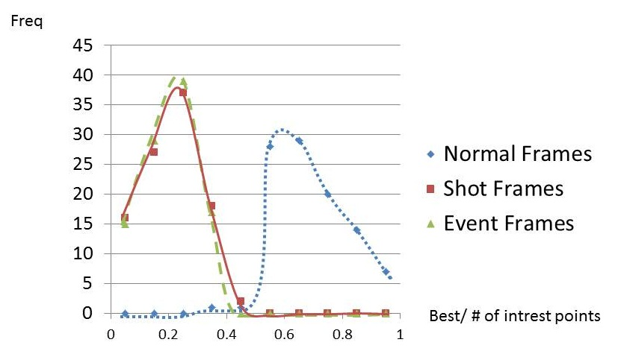
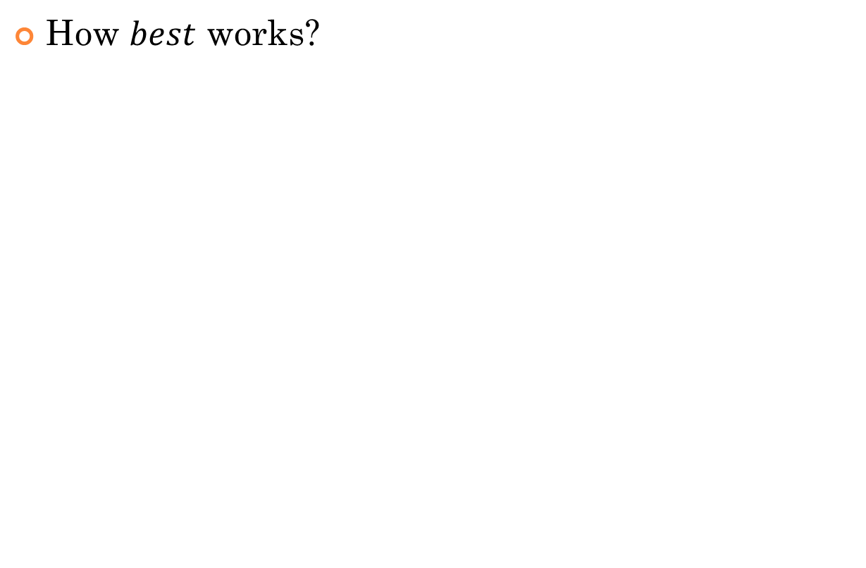
Analysis
How $best$ works?

Slide 23
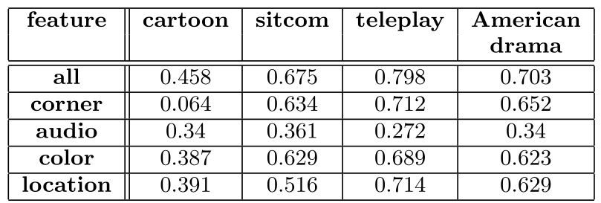
Influence of groups

Slide 24
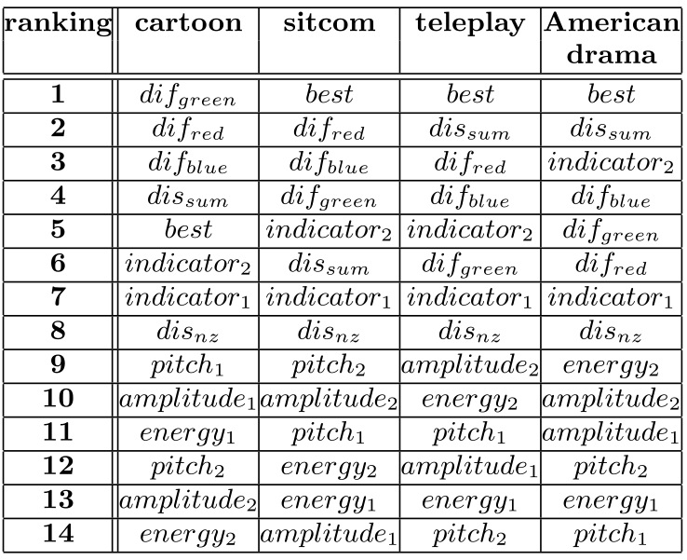
Ranking
Sklearn feature selection

Slide 25
Auditory feature
 | cartoon | sitcom | teleplay | American drama
all feature | 0.458 | 0.675 | 0.798 | 0.703
without audio | 0.432 | 0.656 | 0.76 | 0.691

Slide 26
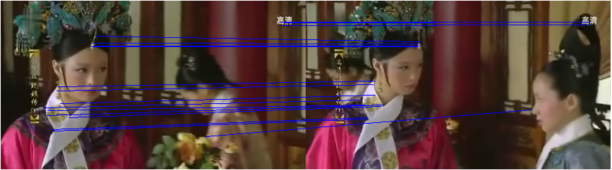
Further explain
No shot change – situations:
no shot shift but roles moving
Corner points in the background – always hard to detect
Color distribution - the best indicator
Camera moves around the roles
Background changes
Projection transformation

Slide 27
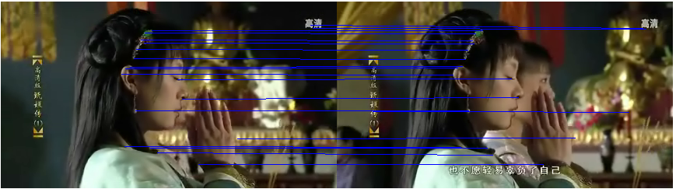
Further explain
No shot change – situations:
no shot shift but roles moving
Corner points in the background – always hard to detect
Color distribution - the best indicator
Camera moves around the roles
Background changes
Projection transformation

Slide 28
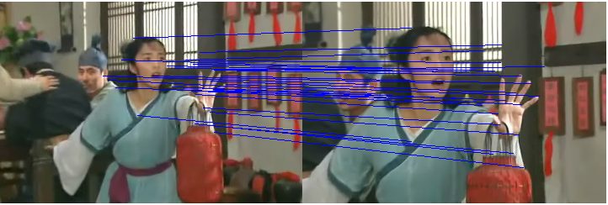
Further explain
No shot change – situations:
no shot shift but roles moving
Corner points in the background – always hard to detect
Color distribution - the best indicator
Camera moves around the roles
Background changes
Projection transformation

Slide 29
Future Work
New feature:
Color
in blocks
HSV space
Auditory feature
More accurate
New model:
Better kernel function in SVM
Ensemble learning
Granularity
Trade off between accuracy and efficiency
New topic:
Sematic event detection

Slide 30
Thank you! Q&A
Yihan Sun
CS&T 05
syhlalala@gmail.com

